Slide 1
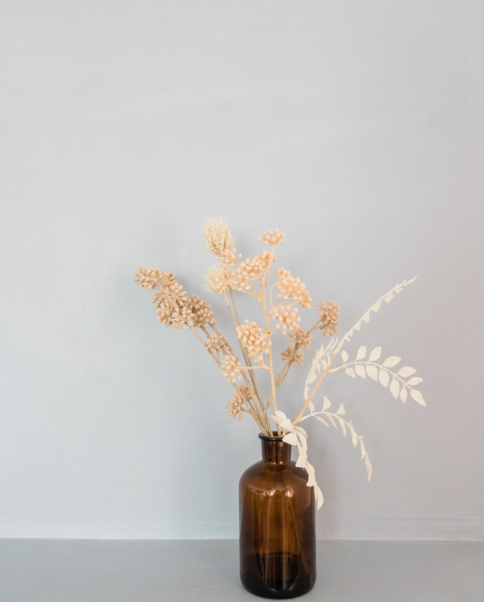
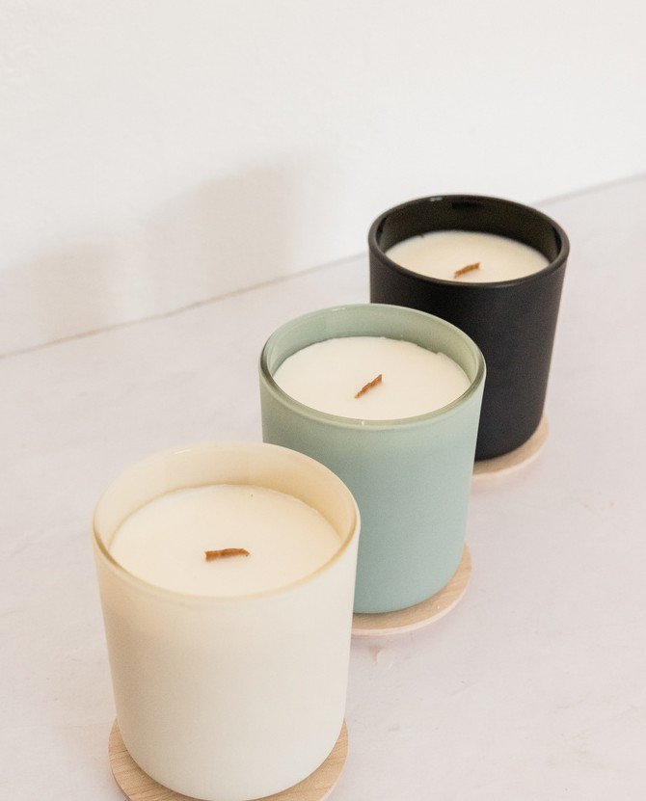
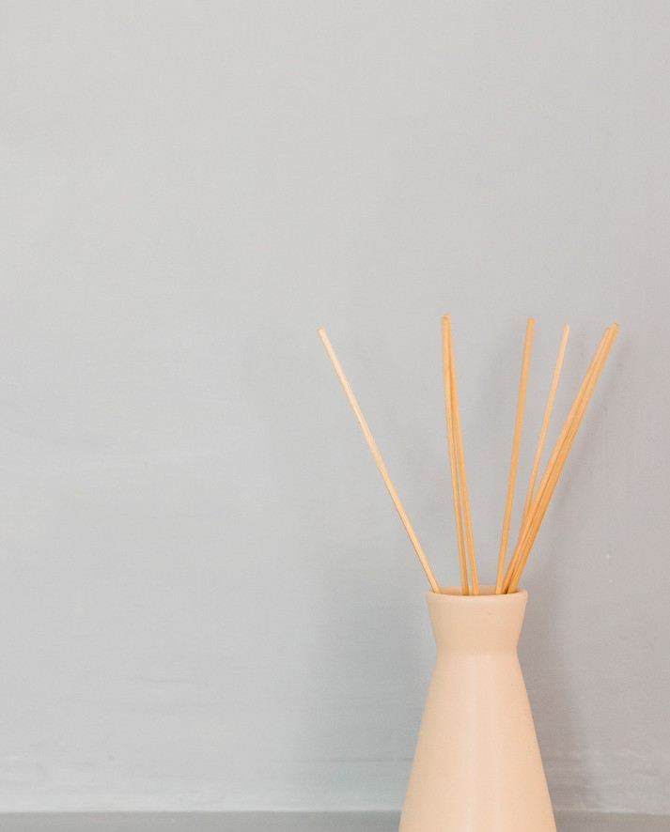
Products
①提供可能な製品を全て記載し、一度に閲覧できるようにします。
②写真、製品・ブランド名、金額（単位）を記載し、
できるだけ端的に、商品PRを記載します。
③ピックアップしたい製品から上から並べましょう。
④製品数が増える場合は、このページをコピーして追加しましょう。
文字が小さすぎたり、多すぎない方が望ましいです。
Fragrance candle
$10.00-$15.00/1piece
color :5colors flavor :5flavors
Enjoy soothing scents and beautiful colors.
Lightweight candles float in your bath.
Fragrance candle
$10.00-$20.00/1piece
color :5colors flavor :5flavors
Enjoy soothing scents and beautiful colors.
Lightweight candles float in your bath.
Fragrance candle
$10.00-$15.00/1piece
color :5colors flavor :5flavors
Enjoy soothing scents and beautiful colors.
Lightweight candles float in your bath.
Fragrance candle
$10.00-$15.00/1piece
color :5colors flavor :5flavors
Enjoy soothing scents and beautiful colors.
Lightweight candles float in your bath.
Fragrance candle
$10.00-$15.00/1piece
color :5colors flavor :5flavors
Enjoy soothing scents and beautiful colors.
Lightweight candles float in your bath.
Fragrance candle
$10.00-$15.00/1piece
color :5colors flavor :5flavors
Enjoy soothing scents and beautiful colors.
Lightweight candles float in your bath.
Fragrance candle
$10.00-$15.00/1piece
color :5colors flavor :5flavors
Enjoy soothing scents and beautiful colors.
Lightweight candles float in your bath.
Fragrance candle
$10.00-$15.00/1piece
color :5colors flavor :5flavors
Enjoy soothing scents and beautiful colors.
Lightweight candles float in your bath.
Fragrance candle
$10.00-$15.00/1piece
color :5colors flavor :5flavors
Enjoy soothing scents and beautiful colors.
Lightweight candles float in your bath.
g
aaaaaaa Co.,Ltd
o
o
l

Slide 2

Products
①提供可能な製品を全て記載し、一度に閲覧できるようにします。
②写真、製品・ブランド名、金額（単位）を記載し、
できるだけ端的に、商品PRを記載します。
③ピックアップしたい製品から上から並べましょう。
④製品数が増える場合は、このページをコピーして追加しましょう。
文字が小さすぎたり、多すぎない方が望ましいです。
Fragrance candle
$10.00-$15.00/1piece
color :5colors flavor :5flavors
Enjoy soothing scents and beautiful colors.
Lightweight candles float in your bath.
Fragrance candle
$10.00-$15.00/1piece
color :5colors flavor :5flavors
Enjoy soothing scents and beautiful colors.
Lightweight candles float in your bath.
Fragrance candle
$10.00-$15.00/1piece
color :5colors flavor :5flavors
Enjoy soothing scents and beautiful colors.
Lightweight candles float in your bath.
Fragrance candle
$10.00-$15.00/1piece
color :5colors flavor :5flavors
Enjoy soothing scents and beautiful colors.
Lightweight candles float in your bath.
Fragrance candle
$10.00-$15.00/1piece
color :5colors flavor :5flavors
Enjoy soothing scents and beautiful colors.
Lightweight candles float in your bath.
OEM
color／flavor／package・・・
Please contact us
g
aaaaaaa Co.,Ltd
o
o
l

Slide 3
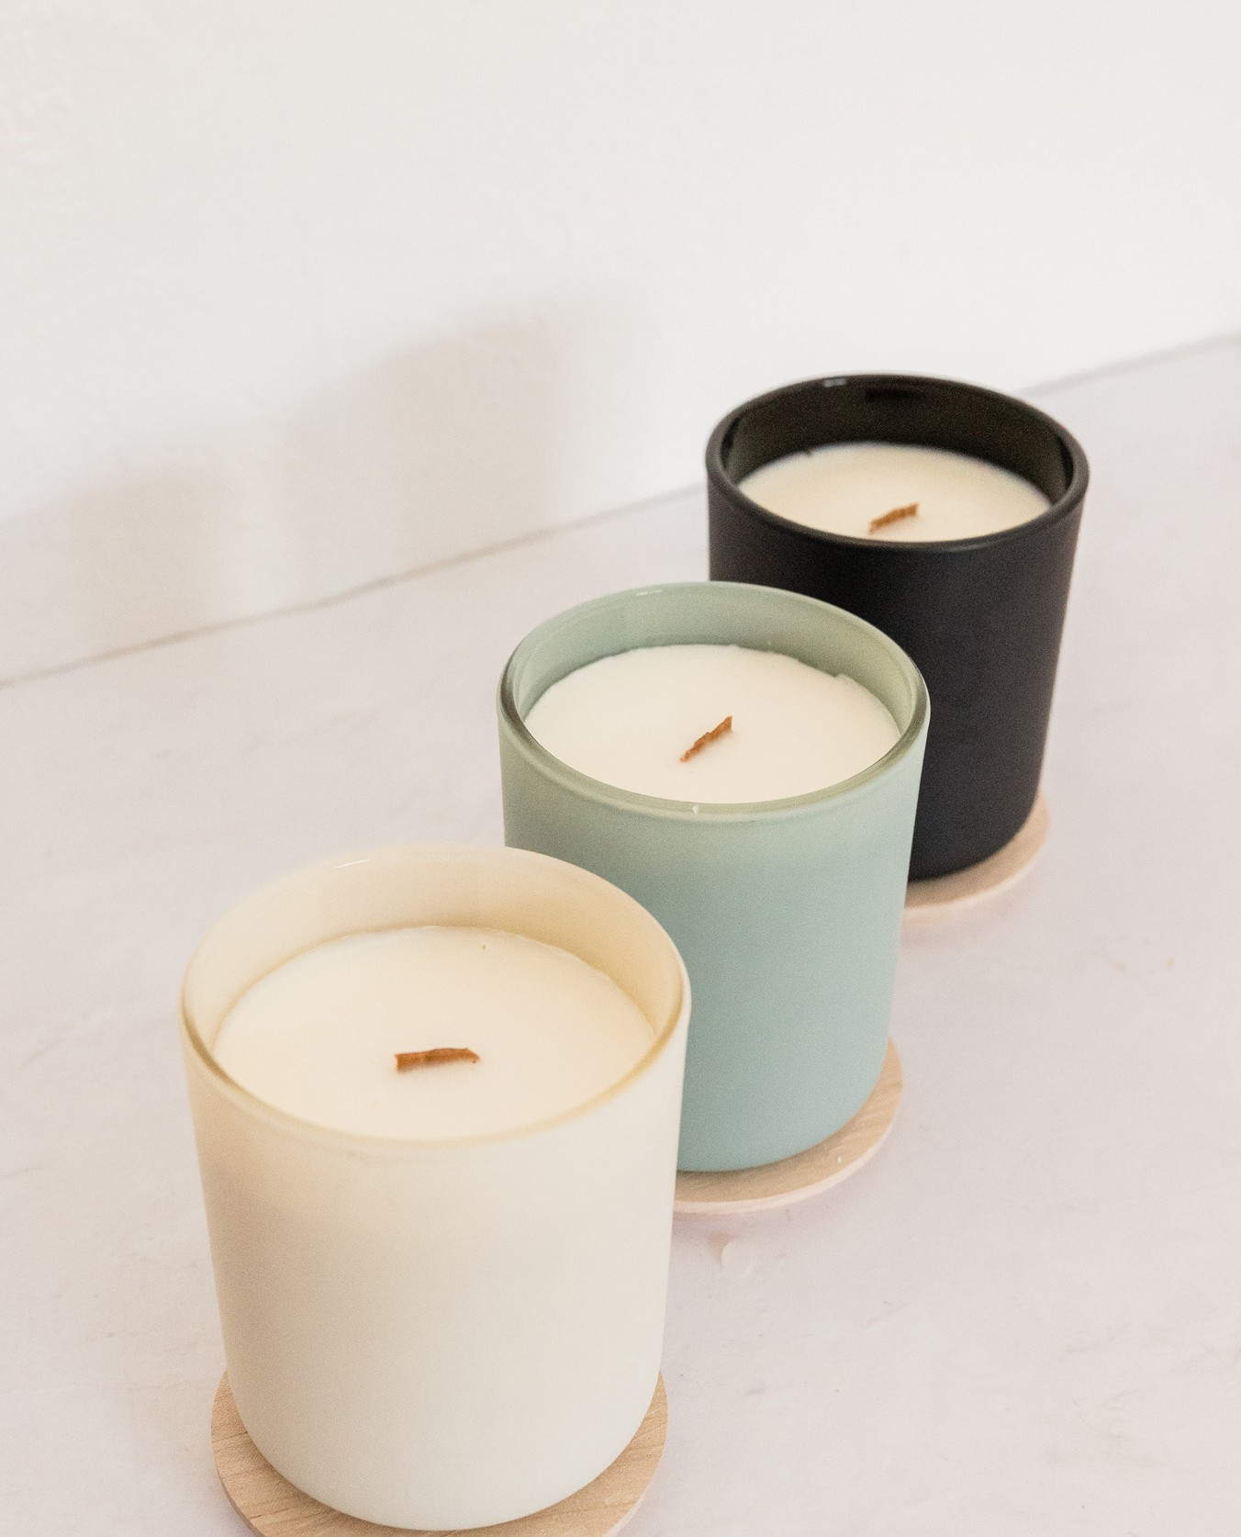

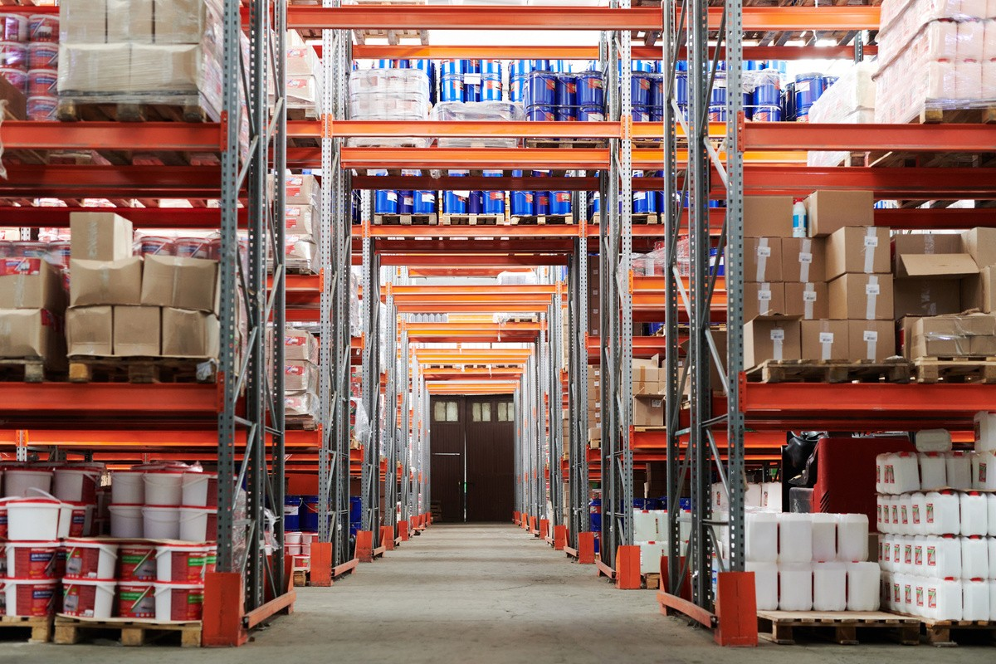
Fragrance
①製品一覧の中でも、とくにPRしたいものは１枚にします。
②１製品か、類似製品の集まるページにして、PR内容を記載します。
③ほかにもPRする製品群がある場合は、このページをコピーしてご利用ください。
Soothing Candles for a Comfortable Moment
Refresh your mind with soothing scents:product nameA
Our candles come in a wide variety of scents that soothe the body and mind. Enjoy a pleasant moment by choosing your favorite scent, such as the relaxing effect of lavender, the restful sleep effect of chamomile, the euphoric feeling of rose, or the meditative effect of sandalwood.
Ideal for relaxing before sleep:product nameB
Our candles are perfect for relaxing at night. Their soft light and gentle fragrance will lull you into a pleasant sleep. By lighting our candles before going to sleep, you can relieve the fatigue of the day and support a good night's sleep. Candles with timer functions are also available for your safety.
Light candles to float in the bath:product nameC
We introduce floating candles that are ideal for relaxing in the bath. Waterproof, lightweight, and safe to use, these designs are designed to be used safely. Float them in hot water and enjoy bath time with a pleasant fragrance.
50 color variations:product nameD
The candles come in an astonishing 50 different colors! You can choose your favorite color to match your room interior. The beautiful color variations are perfect for gifts.
Our candles are perfect for relaxation, for special occasions, and as gifts. Please enjoy a pleasant moment with our healing fragrances and beautiful colors.
product nameA
$10.00-$15.00/1piece MOQ: 10 pieces〜
color :5colors flavor :5flavors
product nameB
$10.00-$15.00/1piece MOQ: 10 pieces〜
color :5colors flavor :5flavors
product nameC
$10.00-$15.00/1piece MOQ: 10 pieces〜
color :5colors flavor :5flavors
product nameD
$10.00-$15.00/1piece MOQ: 10 pieces〜
color :5colors flavor :5flavors
g
aaaaaaa Co.,Ltd
o
o
l

